Slide 1


Cornelius Brian Loe
25/05/2023

Slide 2

Outline
Executive Summary
Introduction
Methodology
Results
Conclusion
Appendix

Slide 3
Executive Summary
In this project, we used CRISP-DM process to make a prediction on a rocket launch first stage landing succession based on historical data of Space X Falcon 9 rocket launches.
We start with data collection, data wrangling, exploratory data analysis (EDA), visual analytics, and predictive analytics.
The aim of this project is to seek if there is any features/factors that can help in launching rocket successfully in the first stage so other companies could replicate it in order to reduce cost.

Slide 4
Executive Summary
We achieved a great percentage of accuracy based on experiments on several machine learning classification models.
However due to the limitations such as inadequate samples, future research and improvement as well as continuous improvement is needed to help space companies address challenges and increase the probability of a successful first landing.

Slide 5
Introduction
Space exploration aims to gather and discover scientific knowledge that could expand human understanding about the universe.
With great interest, many space companies have tried to compete with each other to seek if any other planets are suitable for habitation.
However, the cost for launching rockets are not economical. So, Space X aims to reuse their first stage rocket launch. This could prove much savings for rocket launches in the future.
With our machine learning models, we try to predict if the first stage of a rocket launch will succeed.
We used historical data to see if the first stage will land successfully after completing their mission.

Slide 6

Section 1

Slide 7
Methodology
Outline
Data collection methodology
Collected through Space X REST API and webscraping.
Perform data wrangling (data cleaning and preparation)
Perform exploratory data analysis (EDA) using visualization and SQL
Perform interactive visual analytics using Folium (Interactive Map) and Plotly Dash (Dashboard)
Perform predictive analysis using classification models
Including tuning hyperparameters, comparing results between models, and choosing the best performance model.

Slide 8

Data Collection

Slide 9
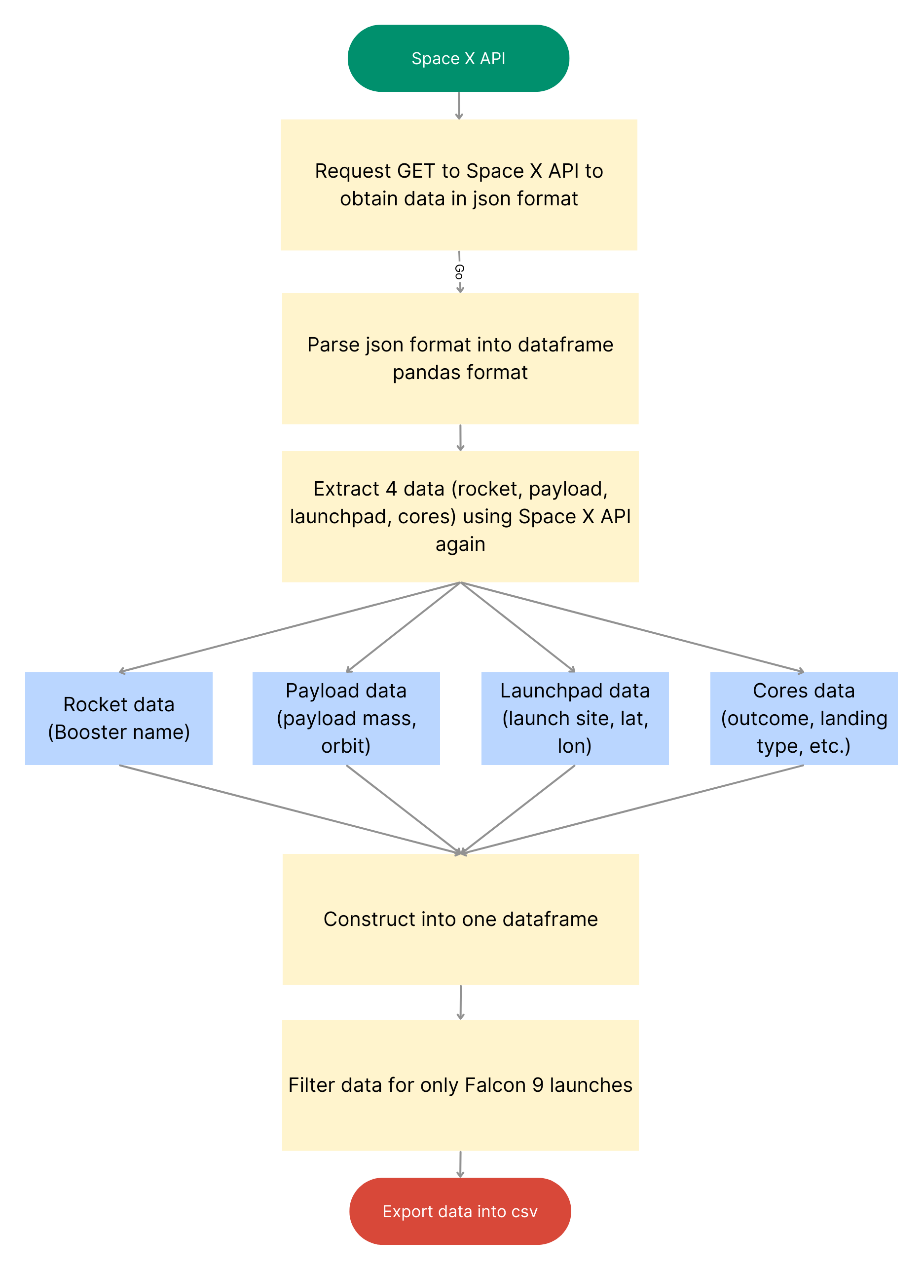
Data Collection |SpaceX API
I collected data from Space X API using REST API.
The data is in json format so I need to transform it to pandas dataframe.
After transforming the data, I extract 4 more data which is information about the rocket, payload, launchpad, and cores.
Construct a dataframe to contain all of those information.
Filter the data so it only contains Falcon 9 launches
Replace missing values in payload mass with the mean.
Export data into csv for next stage.
https://github.com/BrianLoe/Coursera_capstone/blob/main/jupyter-labs-spacex-data-collection-api.ipynb

Slide 10
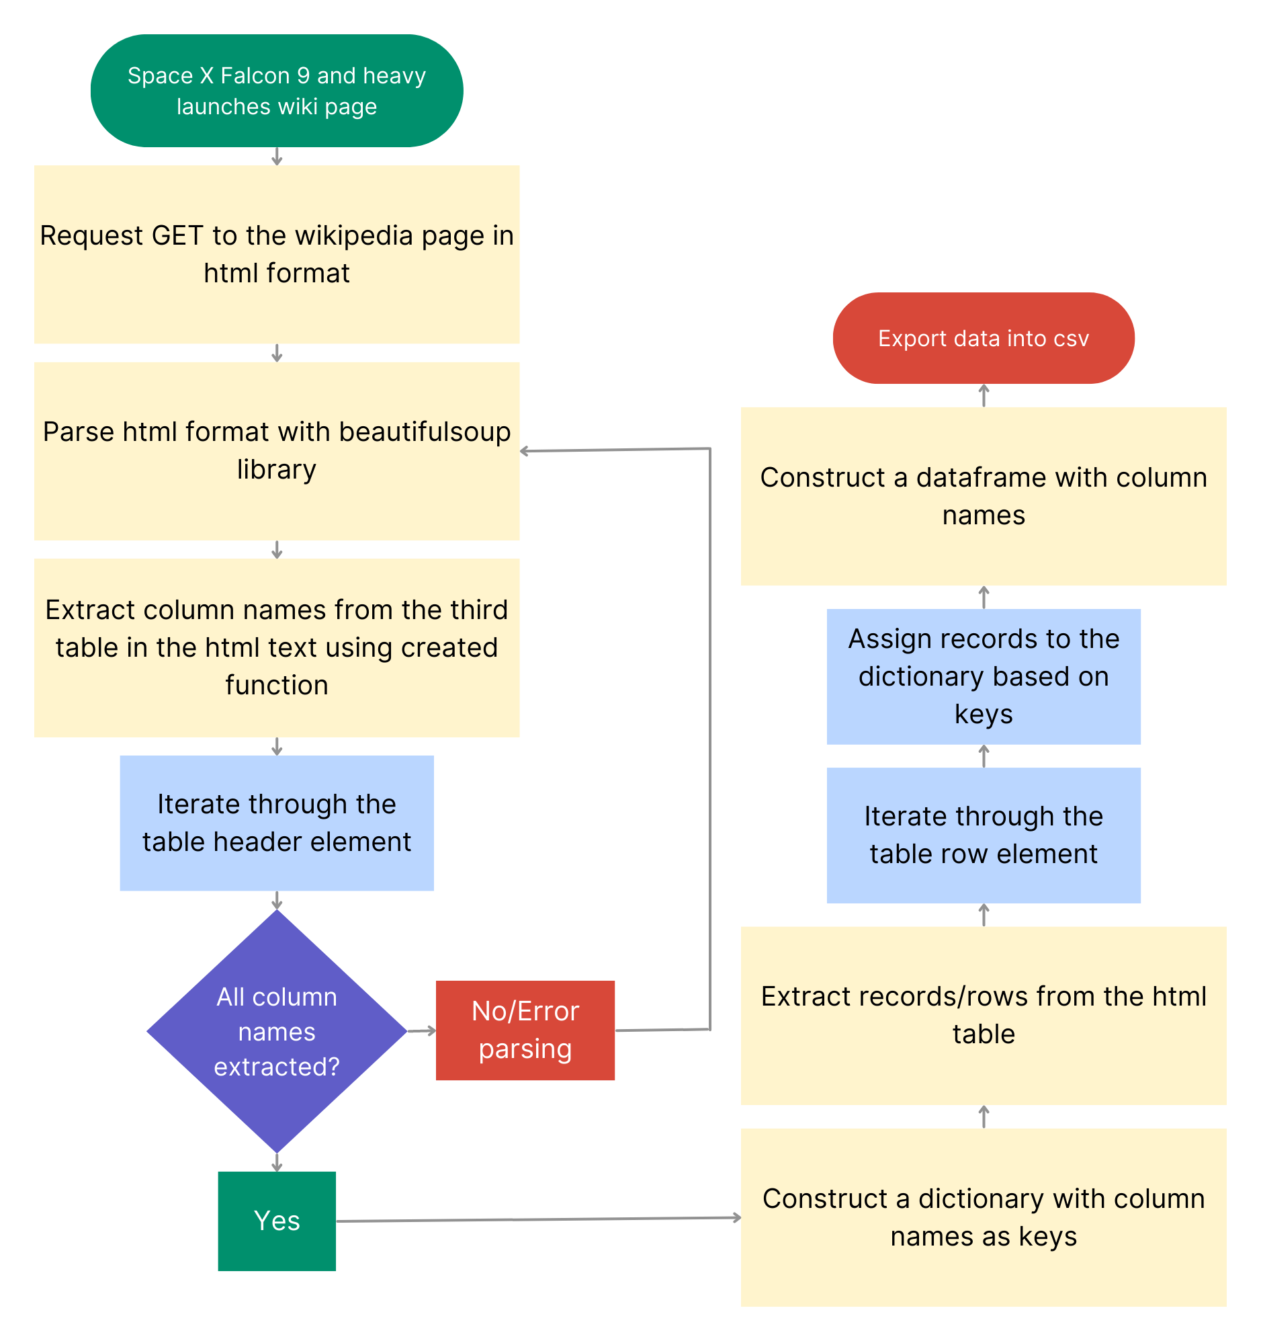
Data Collection |Scraping
I collected data from Space X API wiki page.
The data is in html format so I need to parse it into html readable format.
After parsing the data, I extract column names of the table.
After column names are all extracted, I create a dictionary with them as keys.
I extract the records from the table and assign them to the dictionary.
Then, I create a dataframe from the dictionary
Export data into csv for next stage.
https://github.com/BrianLoe/Coursera_capstone/blob/main/jupyter-labs-webscraping.ipynb

Slide 11
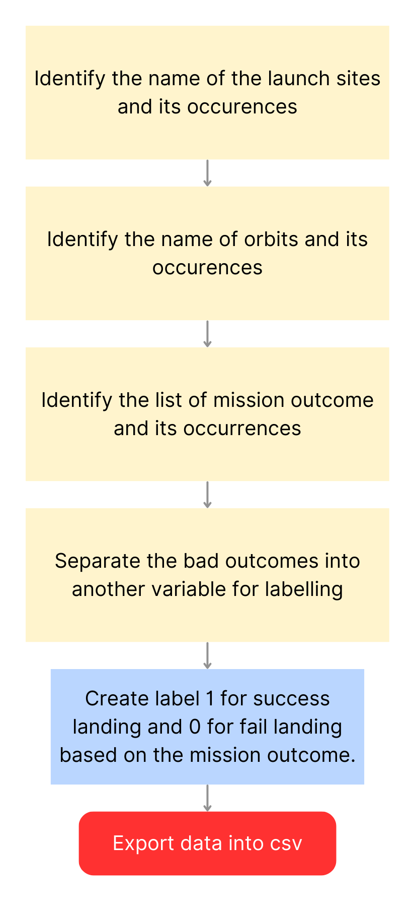
Data Wrangling
I need to identify the name of the launch sites and the orbits as well as its occurrences.
Then I need to list the mission outcomes and its occurrences.
Differentiate the bad outcomes such as none and false outcomes into a set.
Create a label (1 for success and 0 for fail) based on the mission outcome.
https://github.com/BrianLoe/Coursera_capstone/blob/main/labs-jupyter-spacex-Data%20wrangling.ipynb

Slide 12
EDA with Data Visualization
Using Jupyter Notebook with seaborn and matplotlib library, I created graphs and plot for better data visualisation to end user. I also did feature engineering based on the EDA.
Plot and graphs that were used are:
Seaborn categorical plot (catplot), scatter plot to visualise relation between 2 variables
Bar plot to observe relation between categorical variables
Line plot to observe the average success per year rate
Feature engineering:
One-hot encoding for categorical variables
https://github.com/BrianLoe/Coursera_capstone/blob/main/jupyter-labs-eda-dataviz.ipynb

Slide 13
EDA with SQL
Exploration done with SQL are as following:
Identifying all launch site names
Identify records with launch site name starting with ‘CCA’
Display the total payload mass for boosters launched by NASA (CRS)
Display the average payload mass by booster version F9 v1.1
Display the first successful landing outcome date
List the booster names that have success in drone ship and carrying a payload mass between 4000 and 6000 kg.
List the count of success and failure outcomes
List booster names that carried the heaviest payload mass
List 2015 records that failed in landing drone ship
Ranking successful landing outcomes between the date 4/6/2010 and 20/3/2017
https://github.com/BrianLoe/Coursera_capstone/blob/main/jupyter-labs-eda-sql-coursera_sqllite.ipynb

Slide 14
Build an Interactive Map with Folium
Objects that were added into the Folium map are:
Circle – Used to identify all launch sites area location.
Marker – Used to mark the whereabouts of the launch sites
Marker Cluster – Used to mark the success and failed rocket launches based on each site with green (success) and red (fail) color
Mouse Position – Used to determine the lat and lon of the proximity point of interests (highway, cities, coastline, etc.)
Poly Line – Used to visualise the distance between a site and its closest point of interest
https://github.com/BrianLoe/Coursera_capstone/blob/main/lab_jupyter_launch_site_location.ipynb

Slide 15
Build a Dashboard with Plotly Dash
Plots and graphs that are used to build the dashboard:
Pie Chart – to show the successful and failure percentage of a site or all sites. Site can be inputted from the dropdown interaction
Scatter plot – to show the relationship between payload mass and labeled class. Site can be inputted from the dropdown interaction and payload can be adjusted based on the range slider.
https://github.com/BrianLoe/Coursera_capstone/blob/main/spacex_dash_app.py

Slide 16
Predictive Analysis (Classification)
To do predictive analysis, I used classification machine learning models i.e. logistic regression, SVM, Decision Tree, and K-Neighbors.
Each model were developed using Grid search cross validation (Grid search CV). Each model has their own parameters to experiment with.
The aim is to seek the best parameter for each model.
To evaluate it, I used accuracy score to compare between test and validation set, confusion matrix and precision, recall, f1-score.
https://github.com/BrianLoe/Coursera_capstone/blob/main/SpaceX_Machine_Learning_Prediction_Part_5.ipynb

Slide 17
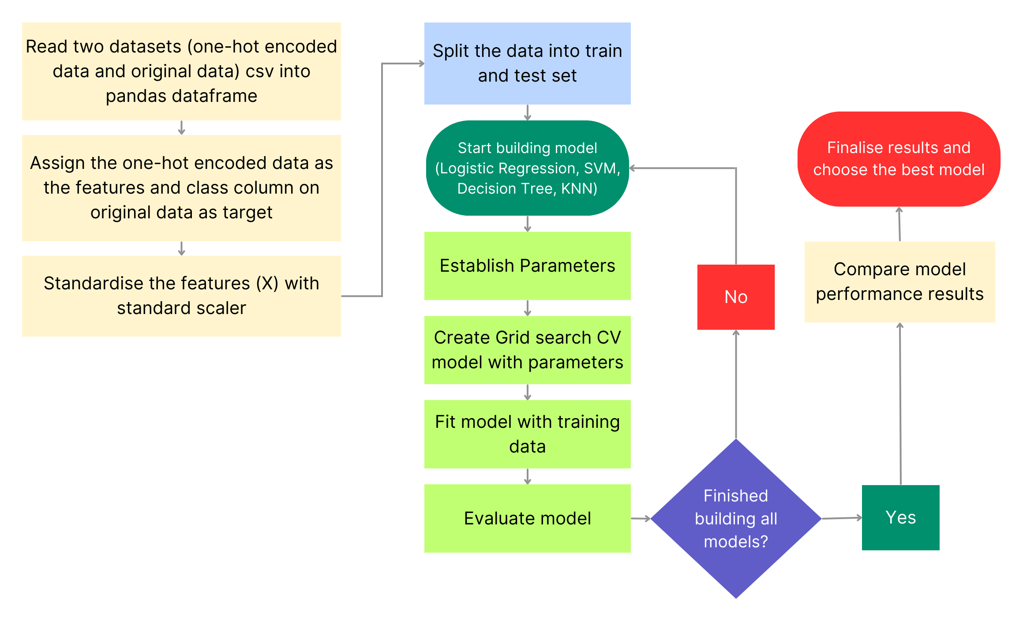
Predictive Analysis (Classification) | Model Development
https://github.com/BrianLoe/Coursera_capstone/blob/main/SpaceX_Machine_Learning_Prediction_Part_5.ipynb

Slide 18
Predictive Analysis (Classification) | Model Development
To develop the model, I standardise the features variable before splitting into training and test set.
Build 4 classification models (Logistic regression, SVM, Decision tree, and KNN).
To develop each model, I use grid search cv with different parameters.
Evaluate each model with accuracy and confusion matrix
Compare model performance results
https://github.com/BrianLoe/Coursera_capstone/blob/main/SpaceX_Machine_Learning_Prediction_Part_5.ipynb

Slide 19

Results

Slide 20
Results | EDA
Each launch site has different success rate with site KSC LC-39A having the highest success rate (77%), then CCAFS LC-40, VAFB SLC 4E, and CCAFS SLC-40 respectively.
There is a positive relation between:
Number of flights and success landing
Payload mass and success landing
Number of flights in each orbit and success landing (no relation in GTO orbit)
Payload mass in each orbit and success landing (no relation in GTO orbit)
There is only small amount of rocket launches with payload mass exceeding 10K kg with none in VAFB SLC 4E.
Orbits SSO, HEO, GEO, and ES-L1 have the highest success rate while orbit SO has the lowest success rate.
The success rate starts to increase after 2013, it peaks in 2019.

Slide 21
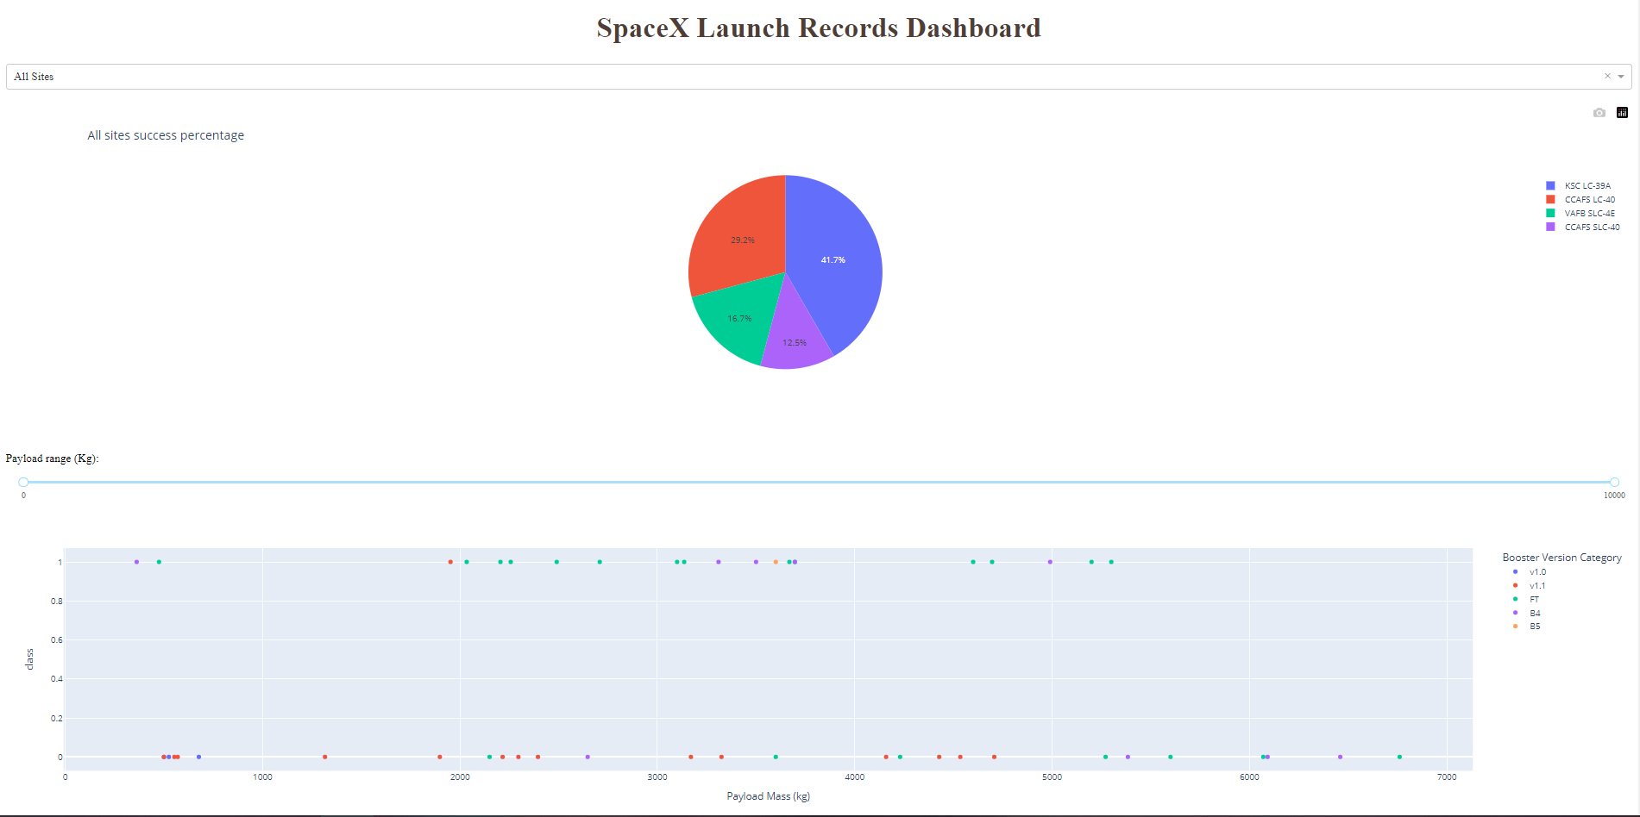
Results | Dashboard demo

Slide 22
Results | Predictive Analytics
After developing the 4 models, I discovered that the model performs better in the validation set.
The accuracy score on test set in all models are the same (83%) except for decision tree (67%).
I used classification evaluation metrics such as precision, recall, and f1-score to further evaluate it to avoid bias in accuracy score.
The f1-score which is the weighted precision and recall calculation. The result is that all model perform significantly worse on predicting class 0 (fail).
Ultimately, the model development were challenged due to limitations such as inadequate number of samples (18) to test with and imbalanced dataset (bias)

Slide 23

Section 2

Slide 24
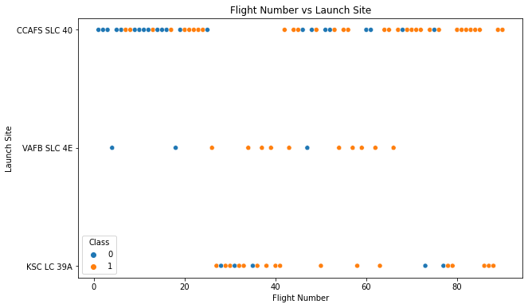
Flight Number vs. Launch Site
Different launch sites have different success rate.
The majority of rocket launch are at CCAFS SLC 40 with KSC LC 39A coming second and VAFB SLC4E in the third.
VAFB SLC 4E and KSC LC 39A have the highest successful rocket launches.
Success rate for CCAFS SLC 40 launch site seems to be dependent on the number of flights.

Slide 25
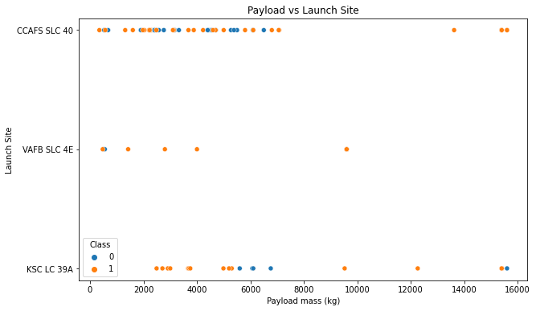
Payload vs. Launch Site
The site VAFB-SLC have no rocket launches that carried payload above 10K kg.
The site KSC LC 39A has higher success rate when the rocket is carrying low payload mass.

Slide 26
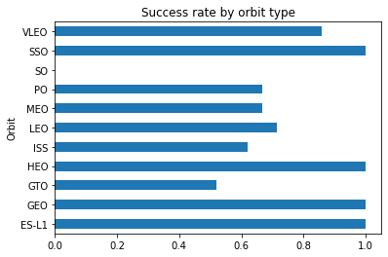
Success Rate vs. Orbit Type
Orbits SSO, HEO, GEO, and ES-L1 have the highest success rate (100%).
Orbit SO has the lowest success rate (0%).

Slide 27
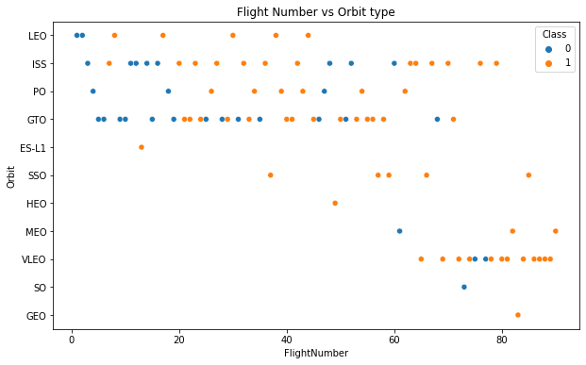
Flight Number vs. Orbit Type
In the LEO orbit, the success rate seems to be dependent on the number of flights.
In the GTO orbit, the success rate cannot be related to the number of flights

Slide 28
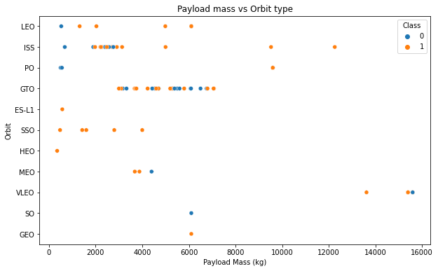
Payload vs. Orbit Type
In the orbits LEO and ISS, there seems to be a positive relation between payload mass and success rate.
In the orbit GTO, even though they carried varied payload mass, there is still some mixed outcome.

Slide 29
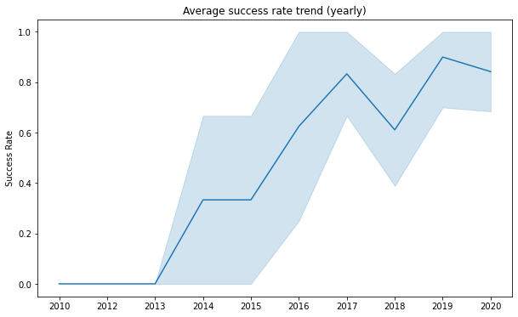
Launch Success Yearly Trend
After 2013, the average success rate starts to increase.
The trend peaks in 2019 where it achieve around 90% success rate.
The trend suffer a drop in 2018 and 2020.

Slide 30
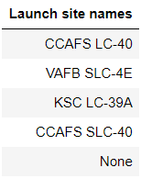
All Launch Site Names
These are the list of launch site names in the data that launches the Falcon 9 rocket.

Slide 31
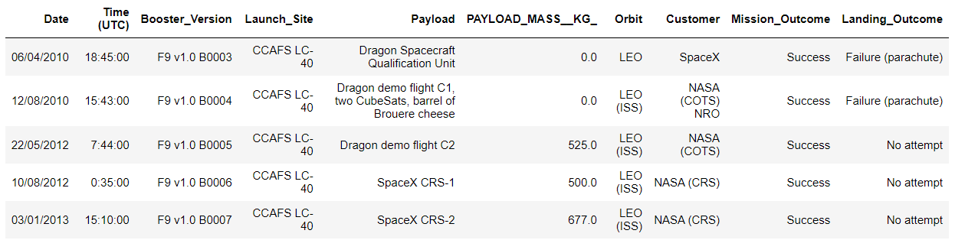
Launch Site Names Begin with 'CCA'
These are an example of 5 records with launch sites name beginning with ‘CCA’.
Based on previous slide, there are two sites with name starts with ‘CCA’ and they are located in same proximity.

Slide 32
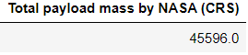
Total Payload Mass
The total payload mass carried by boosters that were launched by NASA (CRS) is around 45.5K kg.

Slide 33
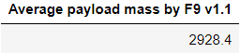
Average Payload Mass by F9 v1.1
The average payload mass carried by booster which version is F9 v1.1 is almost 3kg.

Slide 34
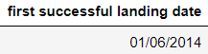
First Successful Ground Landing Date
The date which the first landing outcome in ground pad was achieved was in 01/06/2014.

Slide 35
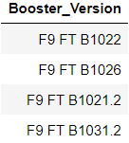
Successful Drone Ship Landing with Payload between 4000 and 6000
These are the names of the booster version that carried payload mass between 4k and 6k that were successful.

Slide 36
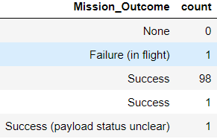
Total Number of Successful and Failure Mission Outcomes
These are the total number of successful and failure mission outcome. It can be seen that almost all of the rocket launches were successful in achieving mission outcome.

Slide 37
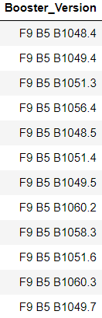
Boosters Carried Maximum Payload
These are the names of booster version that have carried the heaviest payload mass.

Slide 38
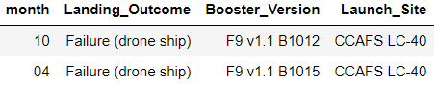
2015 Launch Records
There are two records which the rocket failed to land in drone ship. The two records were at the same launch site.

Slide 39
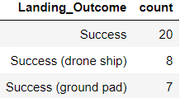
Rank Landing Outcomes Between 2010-06-04 and 2017-03-20
In total there were 35 successful landing outcome with 8 of them drone ship landing and 7 ground pad landing.

Slide 40

Section 3

Slide 41
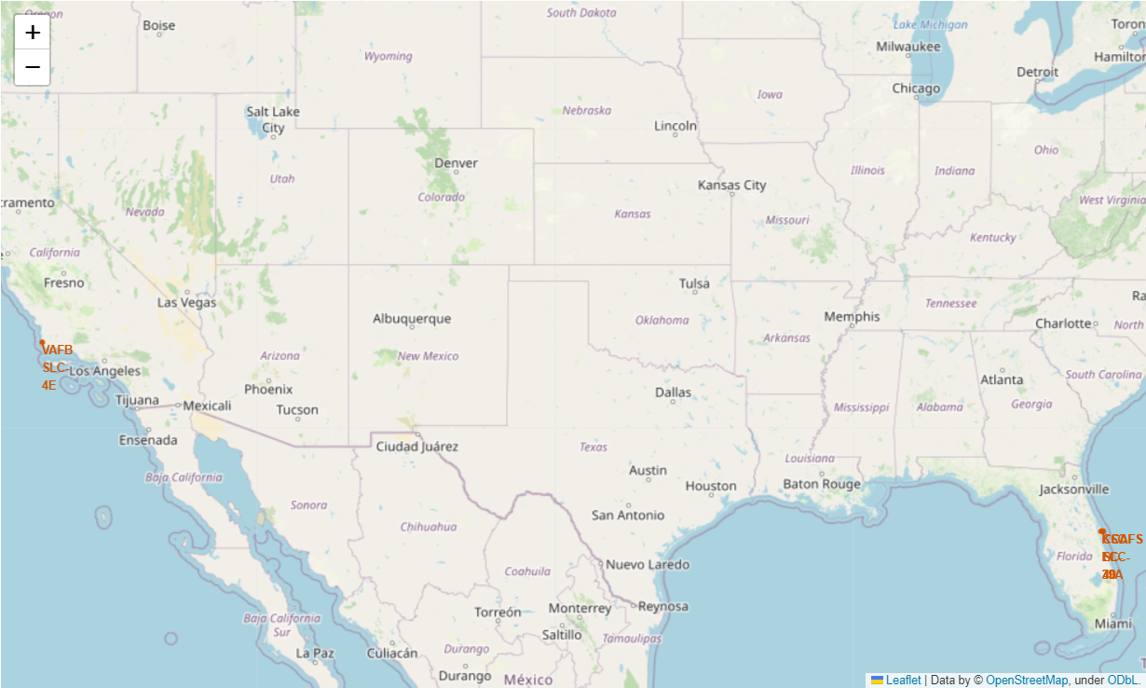
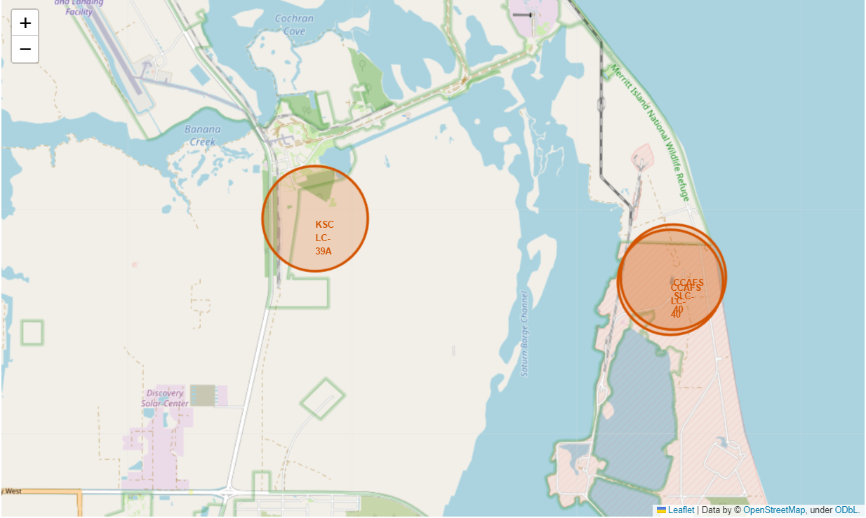
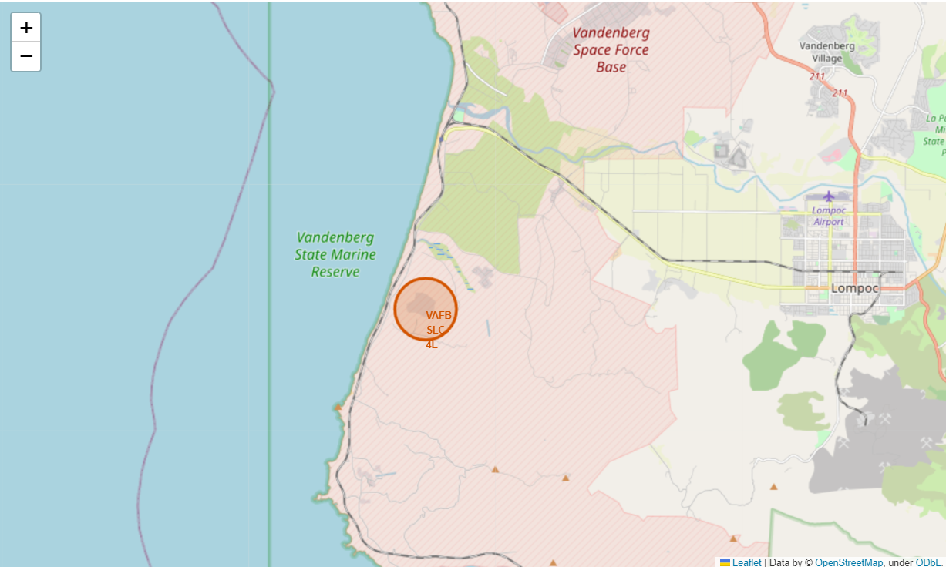
Launch Sites Map Location
There are 4 launch sites that were mapped in here.
3 sites were located close to each other with CCAFS LC-40 and CCAFS SLC-40 located in the same location and KSC LC-39A located nearby in Florida
The VAFB SLC-4E is located in California far from the three sites

Slide 42
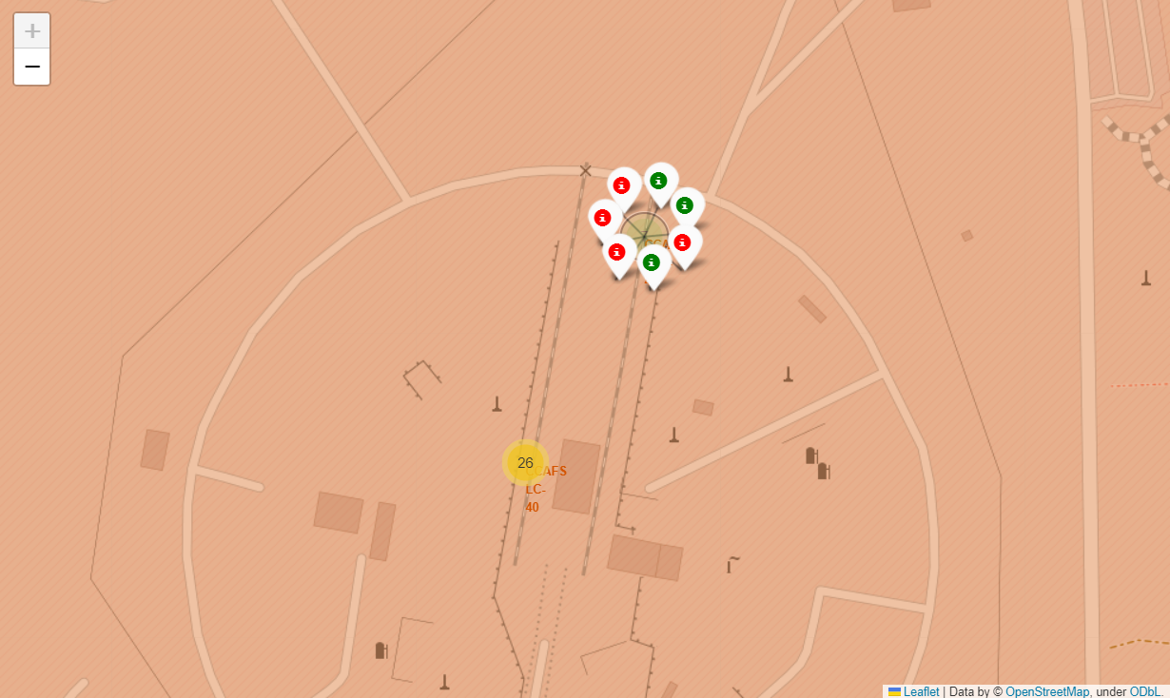
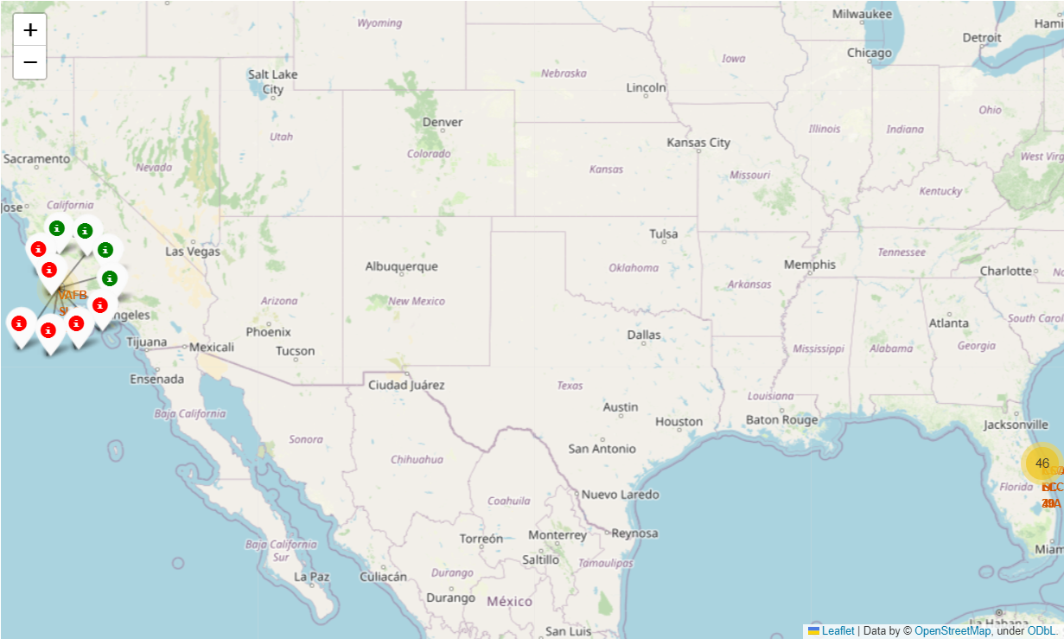
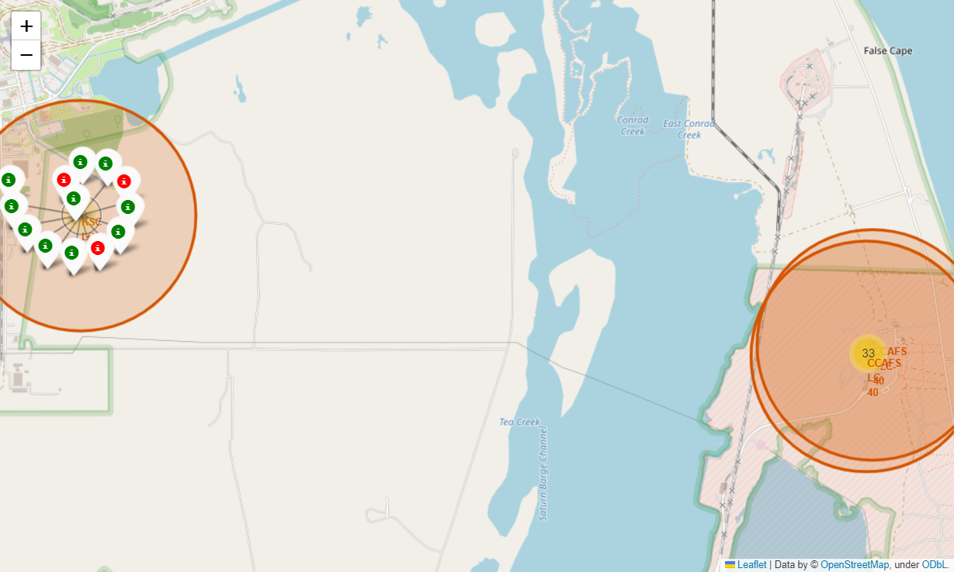
Colored Marked Map
The colored markers indicate whether a rocket has successfully landed or not. It can be seen that at KSC LC-39A site they have high success rate compared to the other sites. Majority of the rockets landed at CCAFS LC-40 site.

Slide 43
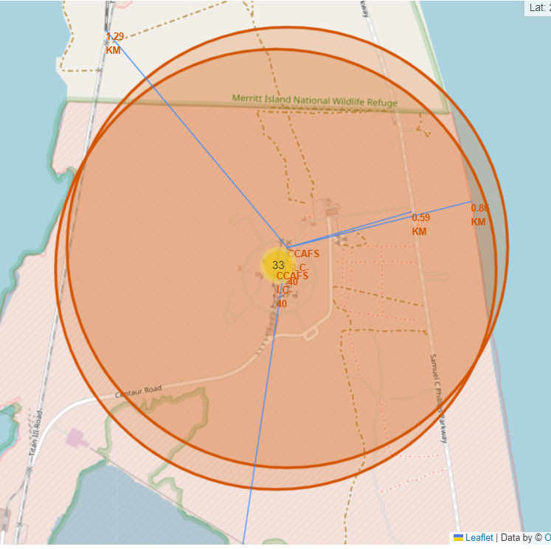
CCAFS SLC-40 Site Proximity Map
The closest coastline is located around 0.86 KM away from the center of the site.
The closest railway is located around 1.29 KM, the closest highway is located around 0.6 KM and the closest city (Cape Canaveral) is located around 18 KM away from the center of the site

Slide 44

Section 4

Slide 45
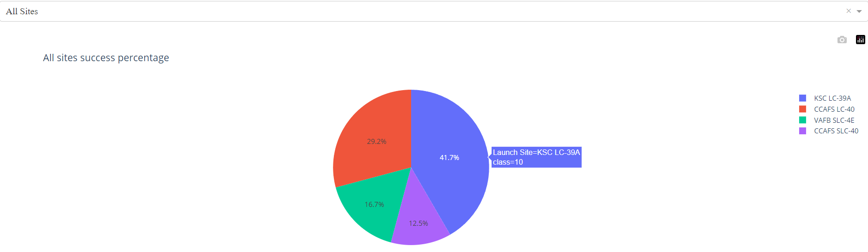
Launch Site Success Rate Pie Chart
KSC LC-39A site (blue) has the highest success percentage of all sites (41.7%).
CCAFS LC-40 site (red) has 29.2%, VAFB SLC-4E (green) has 16.7%, and CCAFS SLC-40 site (purple) has 12.5% (lowest).

Slide 46
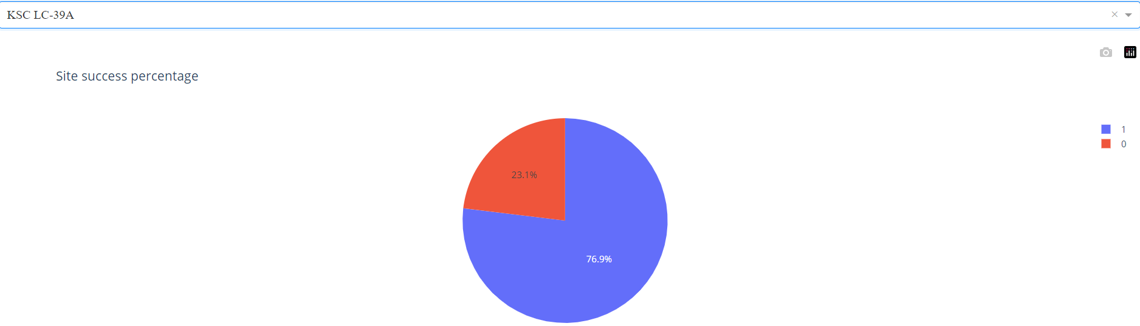
KSC LC-39A Success Rate Pie Chart
With 77% success rate, this site has the highest success rate for landing rocket.

Slide 47
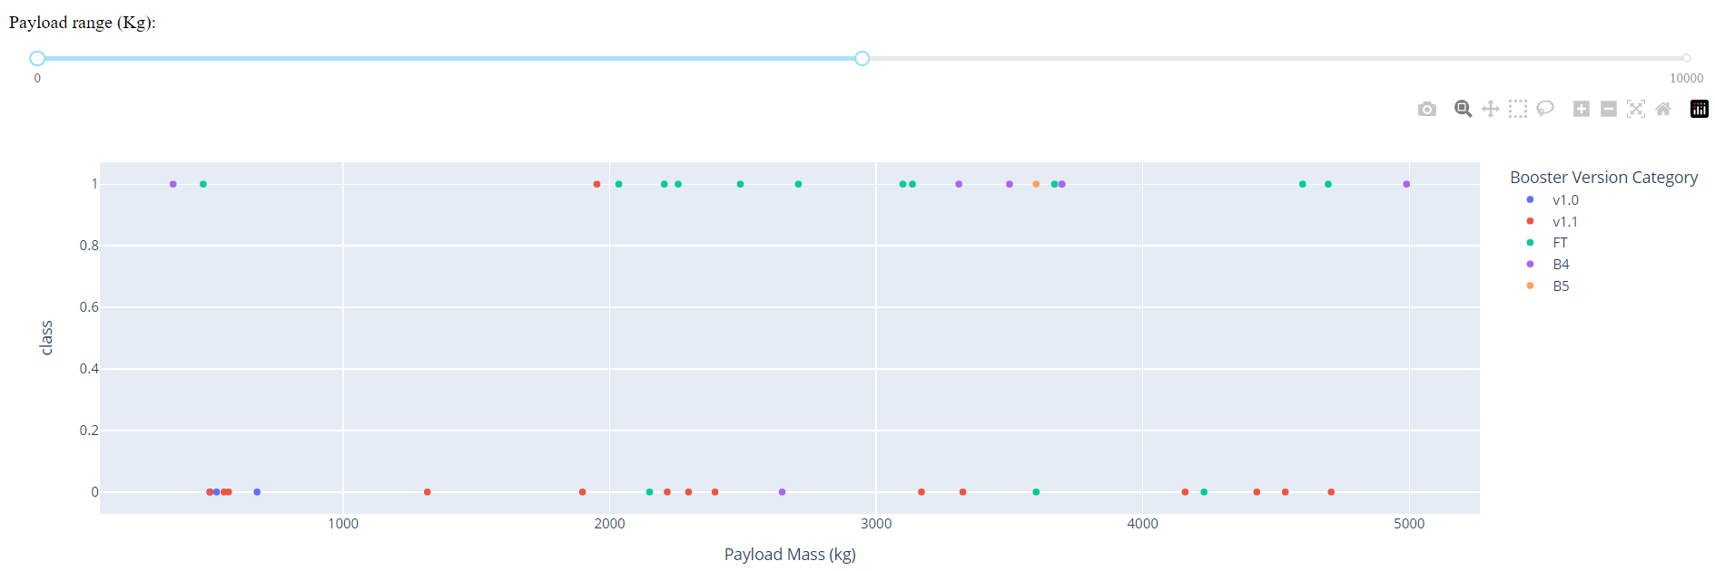
Payload Mass vs Launch Outcome
The scatter plot is filtered to payload between 0 and 5K.
All booster versions still present in the plot. FT version has the highest success rate. Meanwhile v1.0 has zero success rate, v1.1 has one success outcome, B4 version has one failure outcome, and there is only one launch by B5 which is successful

Slide 48

Section 5

Slide 49
Classification Accuracy
Visualize the built model accuracy for all built classification models, in a bar chart
Find which model has the highest classification accuracy

Slide 50
Confusion Matrix
Show the confusion matrix of the best performing model with an explanation

Slide 51
Conclusions
Point 1
Point 2
Point 3
Point 4
…

Slide 52
Appendix
1. Zoomed version of the dashboard

Slide 54
Appendix
Zoomed version of the dashboard
Zoomed version of the launch sites map

Slide 58
Appendix
Zoomed version of the dashboard
Zoomed version of the launch sites map
Zoomed version of the pie charts and scatter plot

Slide 62


